Slide 1

May 15, 2007

Slide 2
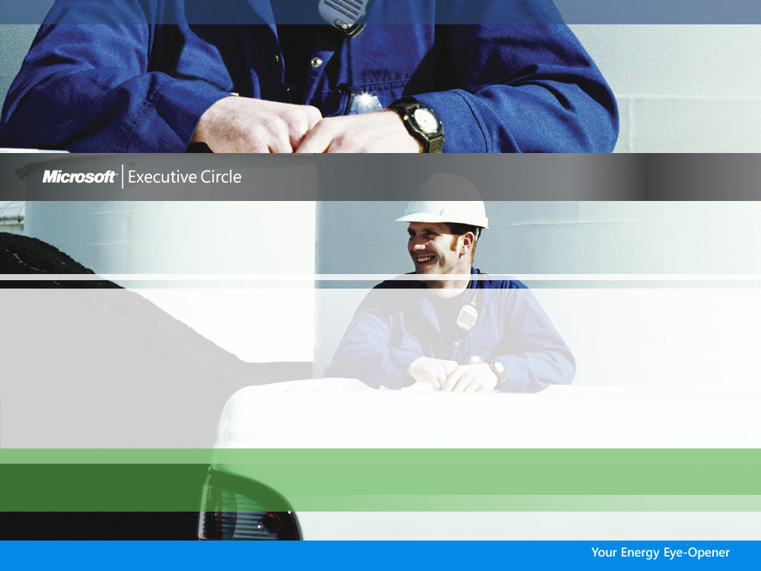
Beyond Recruiting and Retention
Cathy Phillips, Partner
The RANA Group

Slide 3

Beyond recruiting and retention
Emerging Issues & Challenges
Business Drivers for the Future
Beyond Recruiting & Retention:
Workplace Challenges
Implications for Energy Sector HR & IT
Preparing for New Workforce Challenges

Slide 4
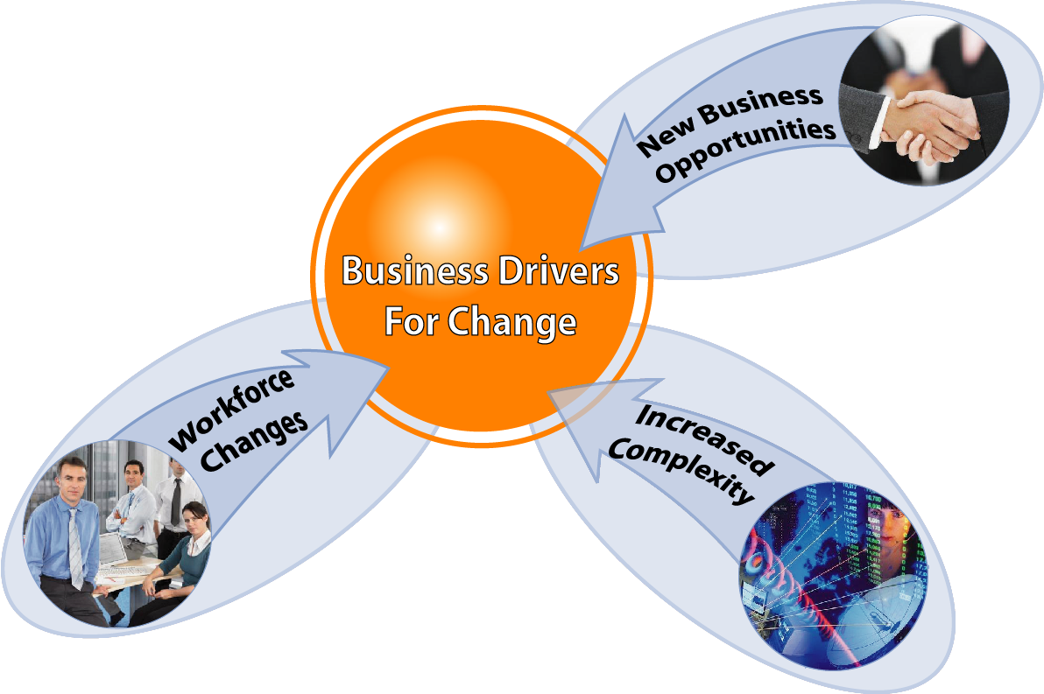
Business drivers for change

Slide 5
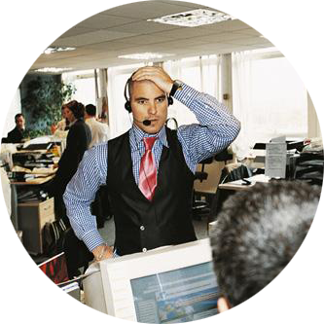



Beyond recruiting and retention
Top Emerging Workplace Issues:
Information overload and ineffective communication
Increased need to collaborate
Corporate culture misalignment
Variation in skill and confidence with technology and complexity
Shortage of skilled leaders
Increasing anxiety and burnout

Slide 6

The bottom line…
Humans have an unlimited
capacity to learn.
We only use about 10% of
the capacity of existing
technology available in a
typical organization.
Imagine the unleashed
potential!

Slide 7
The 10% challenge
If we could access even just another 5% brain power and 5% better use of technology, the difference it would make to productivity, innovation and business results would be enormous!
So how do we unleash our potential?

Slide 8

Preparing for the future
The core of your organization’s
future success starts with:
1
Create a culture for the New World
2
Foster innovation through co-creation
3
Manage the extension of work hours
4
Simplify information overload
5
Create capacity for collaboration
6
Support new skill development
7
Develop HR & IT policies and
practices that enable a successful
future work environment
8
Experience the new world ourselves

Slide 9

Are we ready?
Workforce of the near future will need to be successful based on skills not experience.

Slide 10
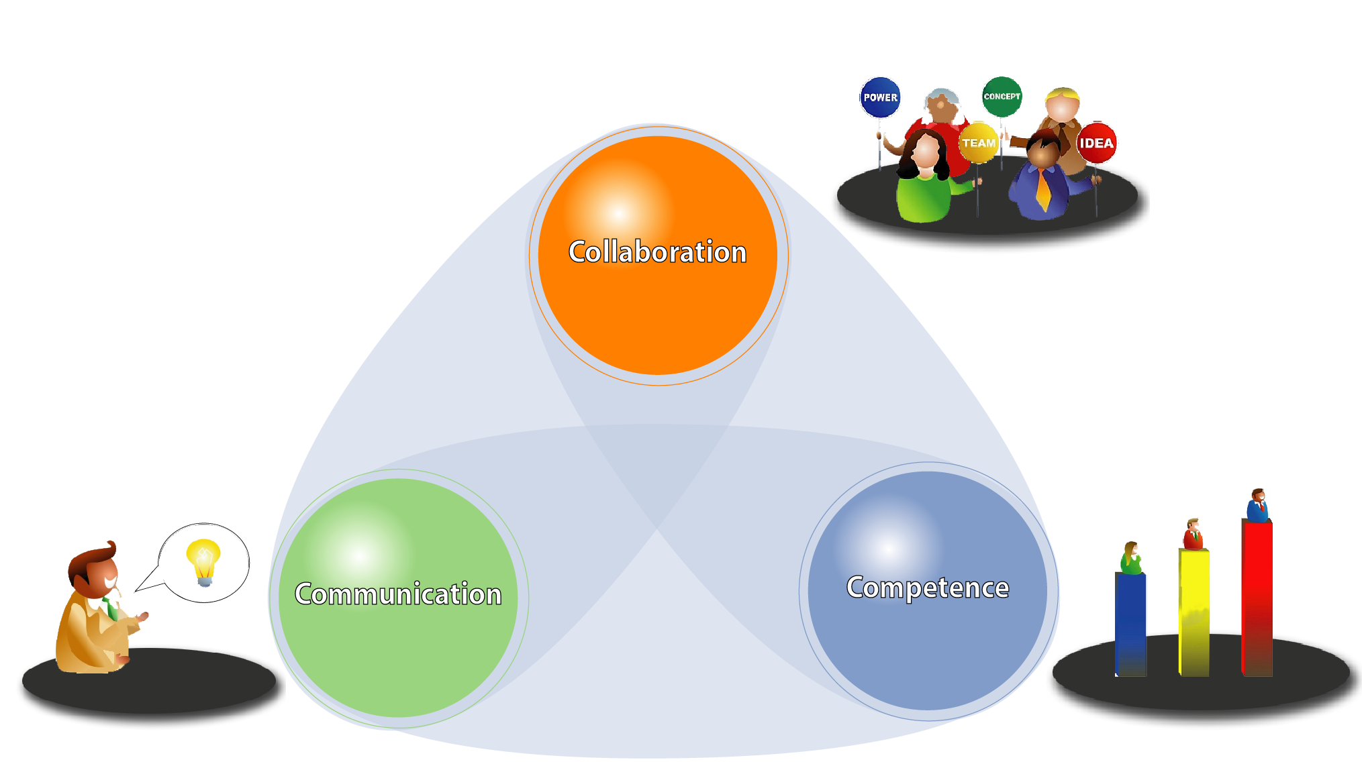
The 3 R’s become 3 C’s

Slide 11

Business Drivers
Emerging Trends
Work together within IT and HR to find the solutions
Let’s tap our future potential!
Get Ready
Get Set…

Slide 12
New World of Work in the Energy Sector
John Amyotte, Solution Specialist
Microsoft Canada

Slide 13
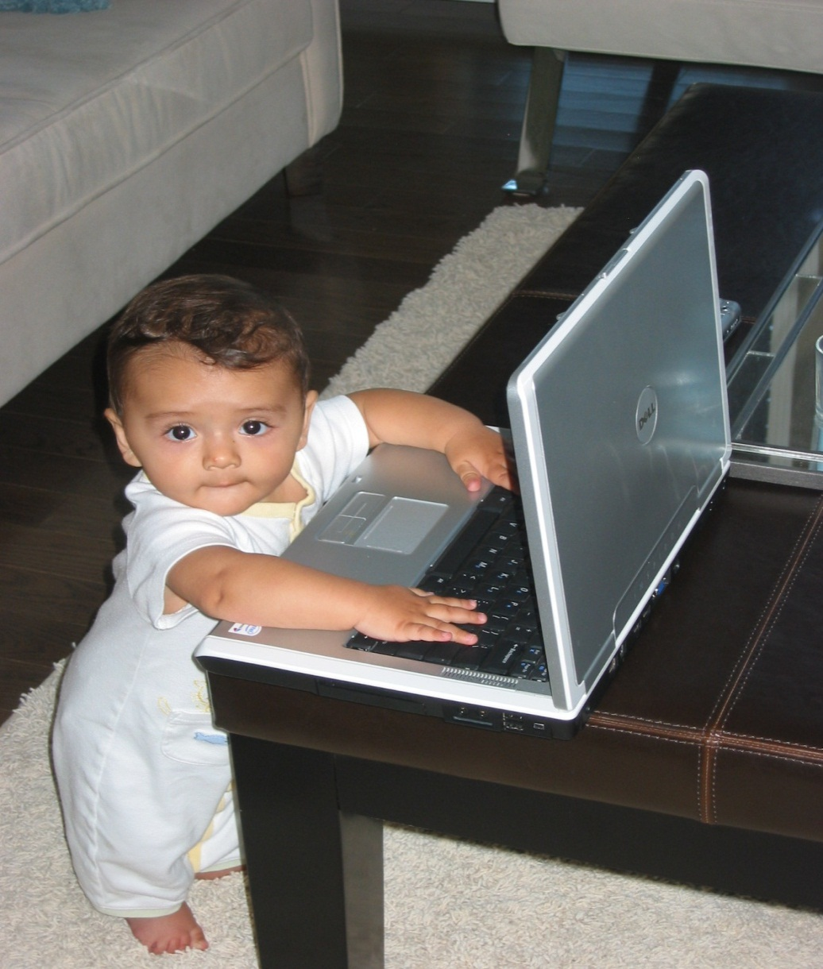
Consulting the “younger generation”

Slide 14



Today’s information challenge
More than 80% of enterprise's digitized information reside in individual hard drives and in personal files and 80% of the data is unstructured, not secure nor backed up.
Employees get 50%-75% of their relevant information directly from other people
Individuals hold the key to the knowledge economy and most of it is lost when they leave the enterprise
Source: Gartner Group/CIBC World Markets

Slide 15
Time spent looking for information?
“Knowledge workers spend 15- 25% (1-2 hrs) of their time hunting for information”
– Forrester
100%
80%
60%
“60% of employees spend more than 1 hour per day duplicating the work of other employees”
– KPMG
% of Respondents
40%
48%
50%
40%
20%
30%
20%
12%
0%
“Most employee portals have an ROI payback within two years”
– Information Week Research
<30 Minutes
30 to 60 Minutes
>60 Minutes
External Information
Internal Information
Source: Forrester Research

Slide 16

Most knowledge is undocumented
Employees are more likely to turn to colleagues for information*
Not in stored in documents
Not in stored in databases
It’s Stored in peoples’ heads
Documented Knowledge
20%
80%
Individual
Knowledge
Source: Delphi Consulting Group

Slide 17
























How simple is communication?
Alex Hankin
Contoso, Ltd.
Senior Director
New York, NY
work
Tel: (207) 555-1000
Tel: (207) 555-1000
Direct: (207) 555-1112
Direct: (207) 555-1112
Fax: (207) 555-9999
Fax: (207) 555-9999
Mobile: (775) 551-2345
Mobile: (775) 551-2345
Home (208) 555-5656
Home (208) 555-5656
Telex: 781 234
Telex: 781 234
Alex Hankin
Senior Director Contoso, Ltd.
alexhankin@contoso.com
Work Email: alexhankin@contoso.com
Work Email: alexhankin@contoso.com
Work IM: alexhankin@contoso.com
Work IM: alexhankin@contoso.com
mobile
Home Email: Alex@hotmail.com
Home Email: Alex@hotmail.com
Home IM: Alex@hotmail.com
Home IM: Alex@hotmail.com
Skype: AlexH
Skype: AlexH
alexhankin@contoso.com
alexhankin@contoso.com
alexhankin@contoso.com
alexhankin@contoso.com
alexhankin@contoso.com
alexhankin@contoso.com
alexhankin@contoso.com
alexhankin@contoso.com
alexhankin@contoso.com
alexhankin@contoso.com
home
51 messages/day in up to 7 different places
50% of the calls require phone number look
60% of calls wasted in phone tag and voice mail

Slide 18
Gen-Y meets Gen-X meets Baby-Boomers
Gen-Y technology use
This generation uses technology at greater rates and in different ways than those from other generations
97% own a computer
94% own a cell phone
56% own an mp3 player
76% use Instant Messaging
15% of IM users are logged on 24 hours a day/7 days a week
34% use websites as their primary source of news
28% own a blog and 44% read blogs
49% download music using peer-to-peer file sharing
69% of students have a Facebook account
Source: Connecting to the Net.Generation

Slide 19
People Ready in the New World of Work

Slide 20


Mega Trends: New World of Work
One World of Business
Collaboration
Nomadic Workforce
Consolidation and Convergence
Transparent Organizations
Regulatory Compliance
Privacy Rights
Integration and Interoperability
People Drive Success
Changing Workforce
Demographic Changes
Projected Talent Shortfall
“Consumerization” of IT
Always On, Always Connected
Work & Family Life Balance
Information vs. Insight
Software and Services Spectrum

Slide 21
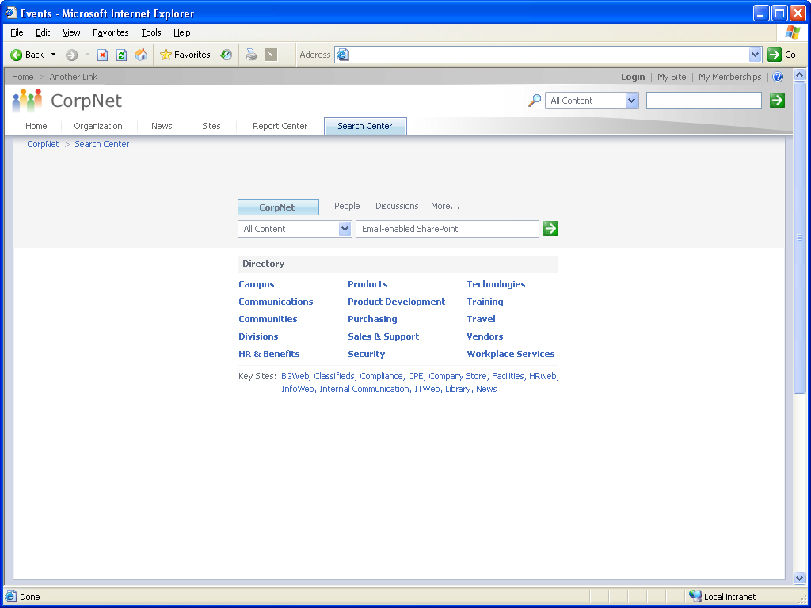
Looking for information?
Tab Interface:
Safety
Operations
Field
Search for
“well 12345”

Slide 22

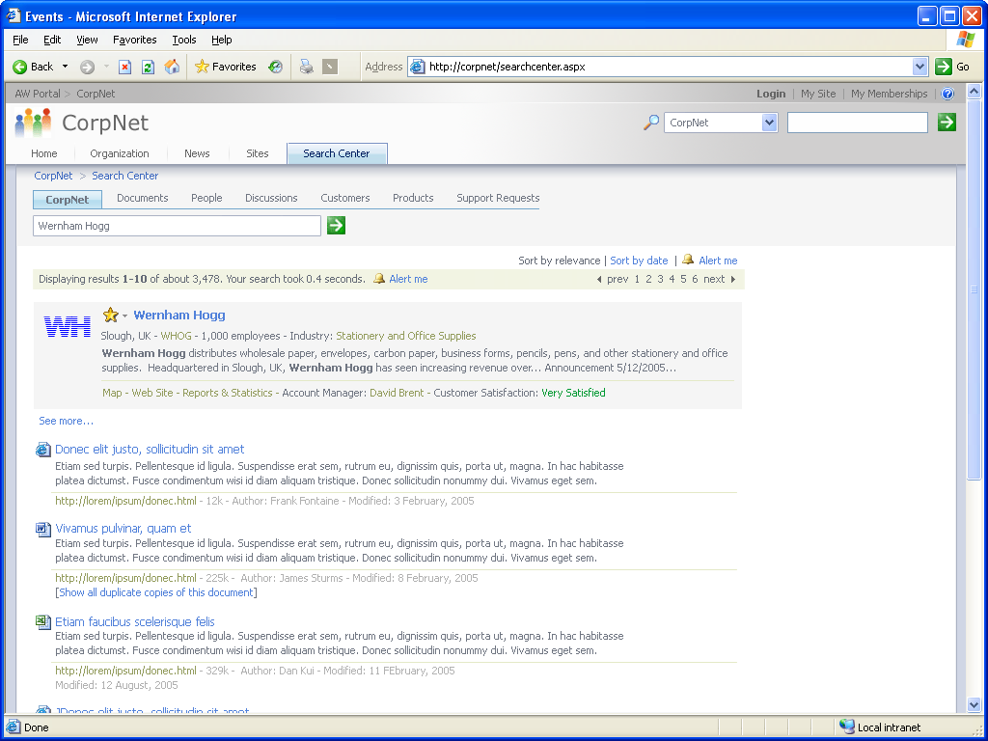
Unified Search- simplify!!
Search
Customer /Employee data from SAP
Well logs
Production data
MSDS

Slide 23
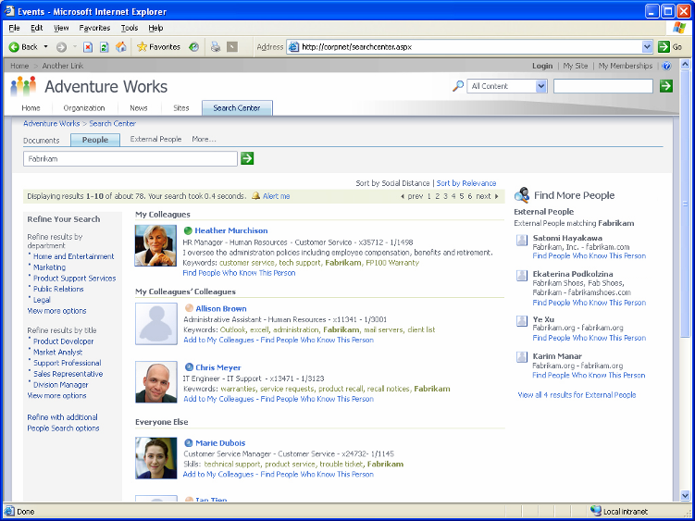

Find and contact - people and experts
Find external contacts and contact colleagues who know them
Locate and contact people and experts associated with keyword “well 12345”
Find experts by role:
Foreman
Production engineer
Reservoir engineer
Geologists
Mineral land Man
trades

Slide 24
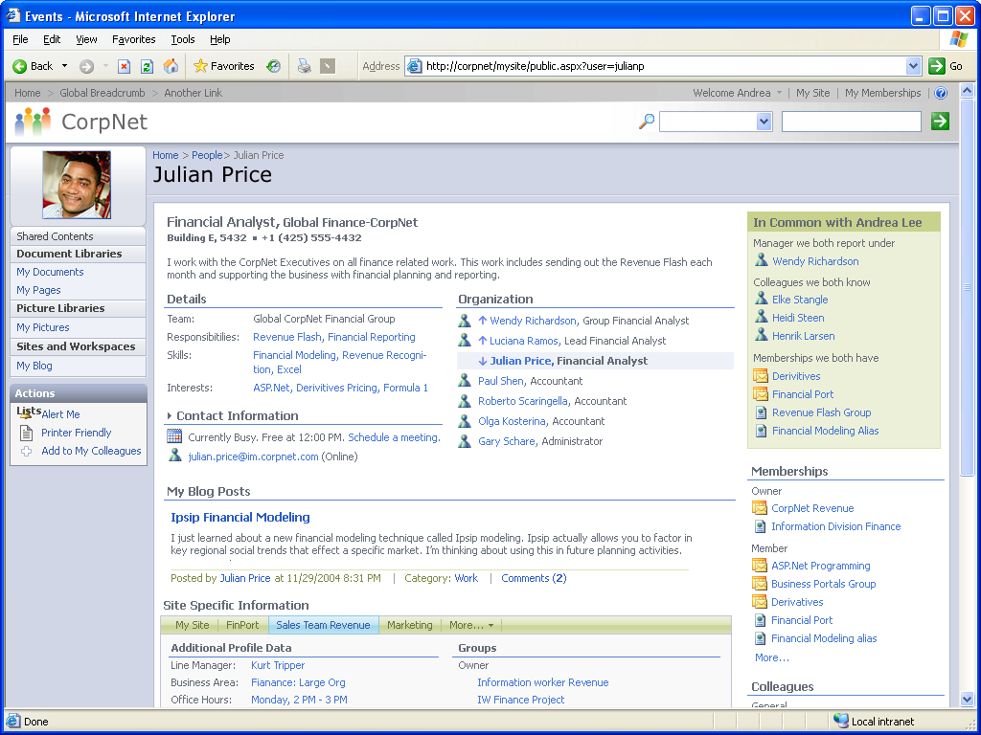
Foreman “My Site”- public
Julian leads a “sour gas” COP; Mentorship; Succession Planning
Drilling crew
Profile and communities
“Well 12345” blog
Production data,
well logs,
safety reports

Slide 25
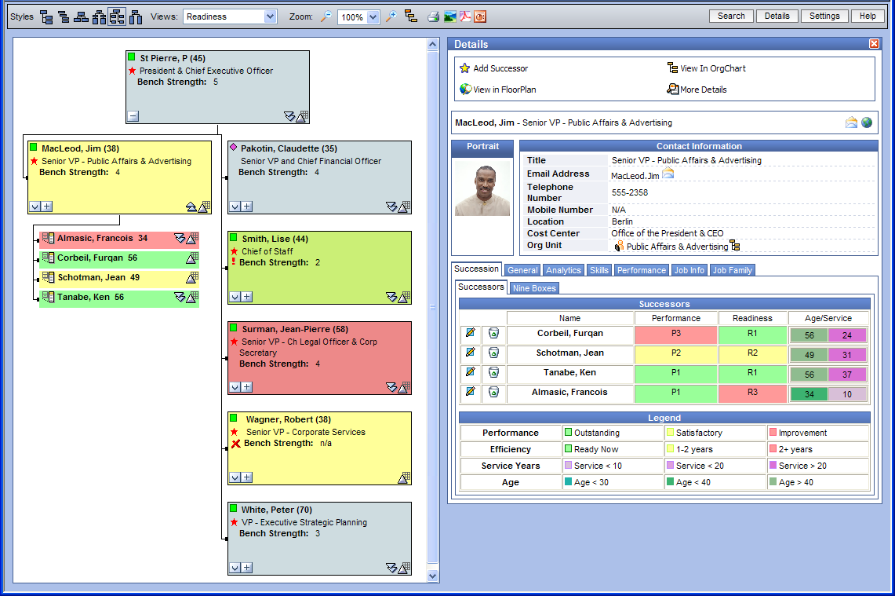
Org chart and talent management
View potential successors
View incumbent and successor profiles

Slide 26
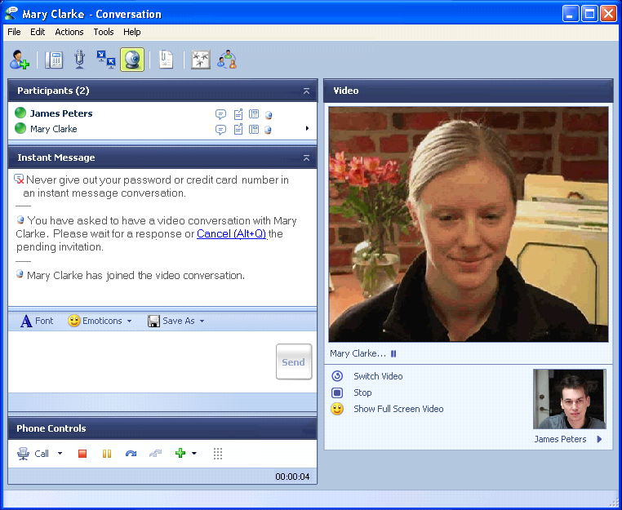
Communicate in real time
With one click
Make a phone call, with subject line
Start an instant message
Start a web conference
With an available resource

Slide 27
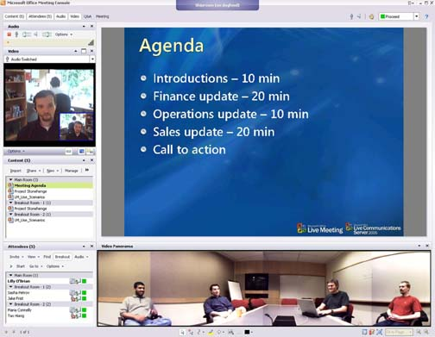
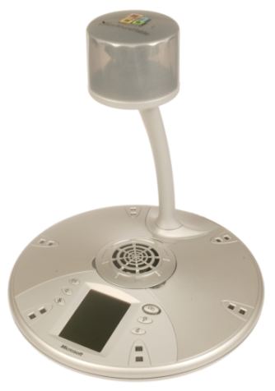
Communicate in real time
One click … team meetings
Web conference… with video
Record for training
Find and reuse

Slide 28
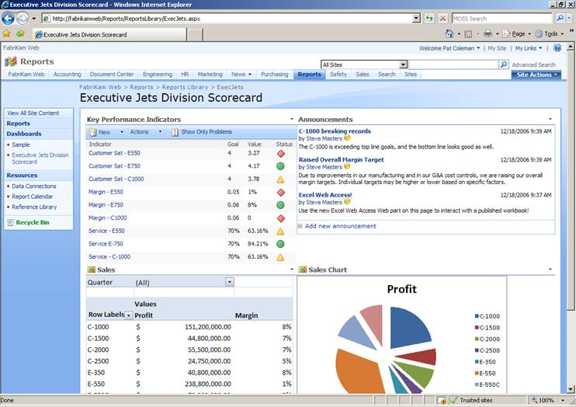
Operations “Team Site”
Safety scorecard
Announcements
Capital budget

Slide 29
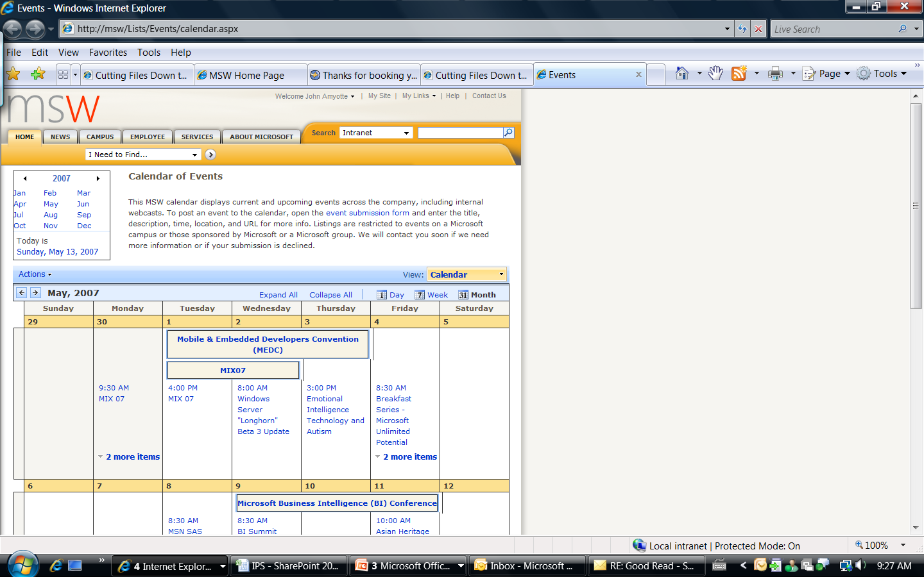
Operations “Team Site”
Team calendar
Turn-around schedule
Safety meetings
Events

Slide 30
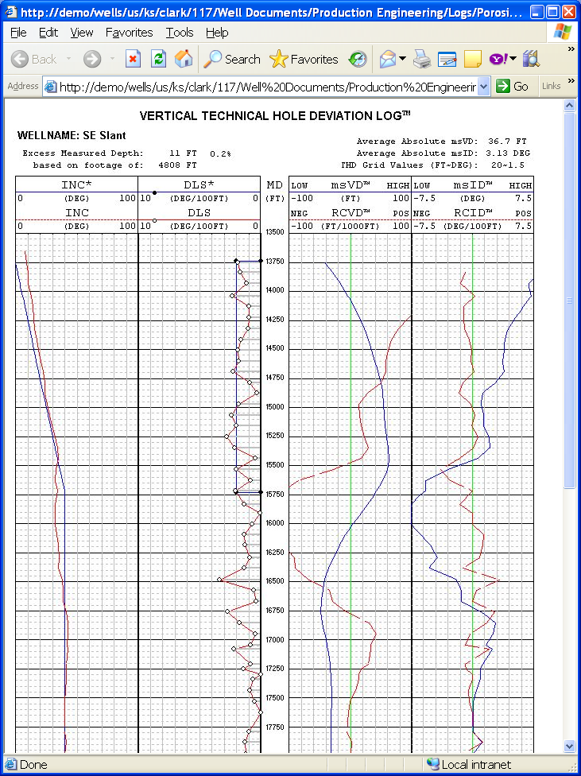
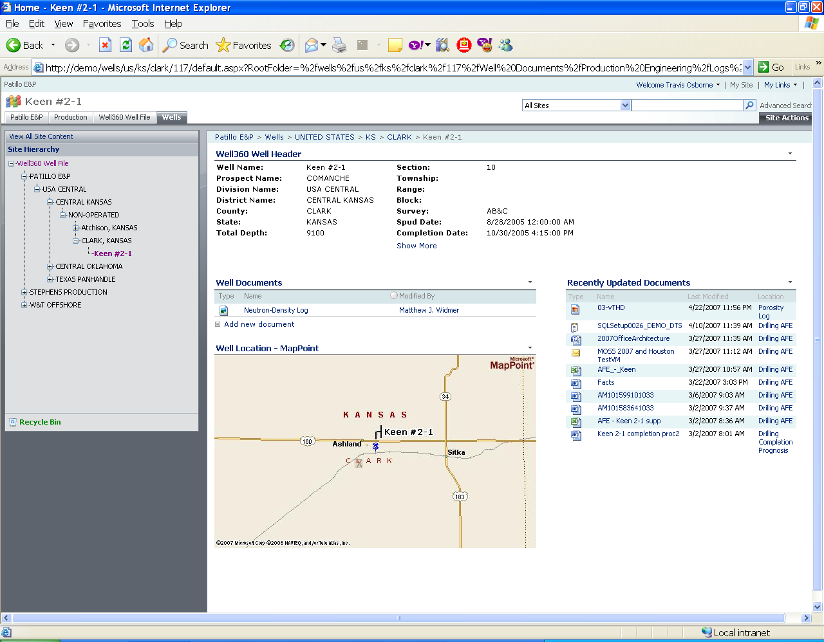
Operations “Team site” well log well 360°
Notes:
30

Slide 31
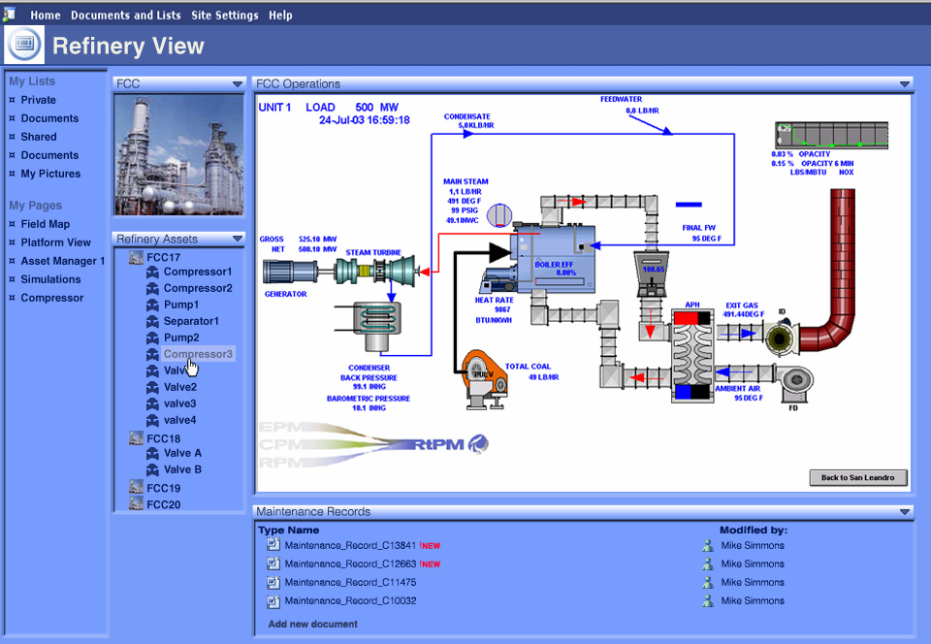
Is this refining? Or collaboration?

Slide 32
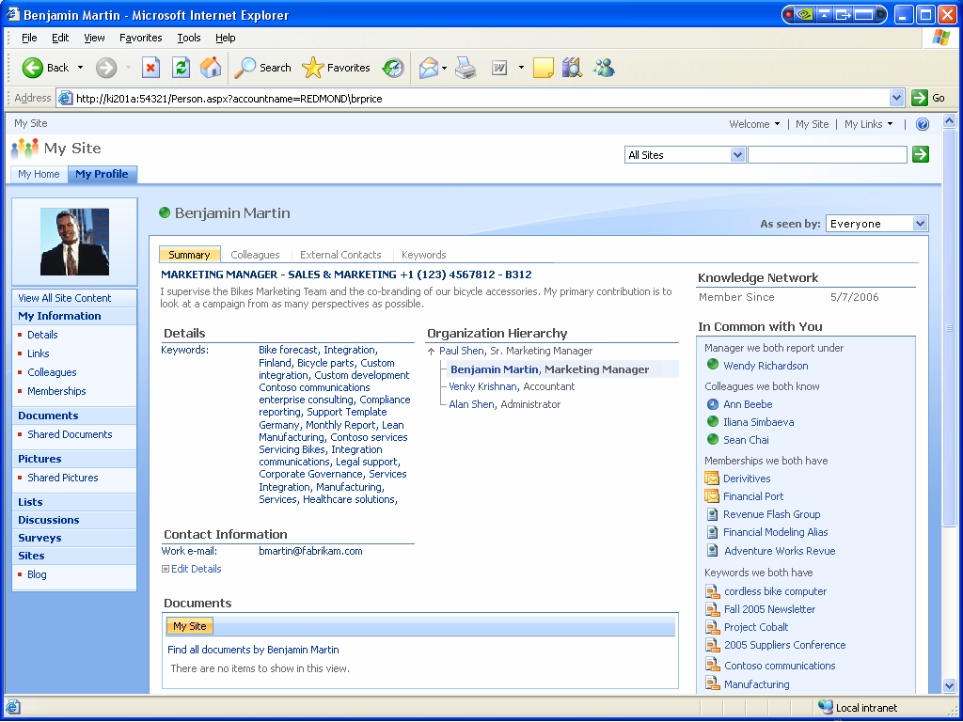
“My Site” private
Profile detail tabs
My colleagues
External contacts
Keywords
My profile
My documents
My career Plan
My HR (vacation)
My competencies
My communities
My Wiki’s
My blogs
My news (RSS)
Keywords in common

Slide 33
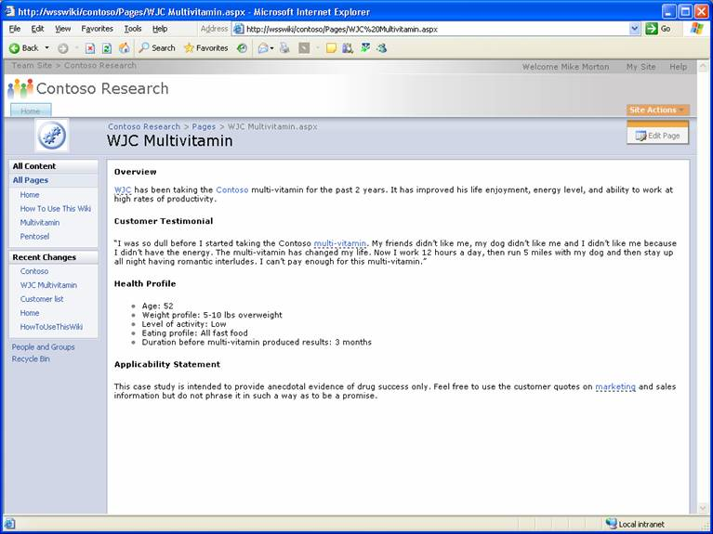
Wiki’ – live documents
Business examples:
Project wiki
COP
On boarding
Innovation
Safety
R&D
Geologists
Engineering

Slide 34
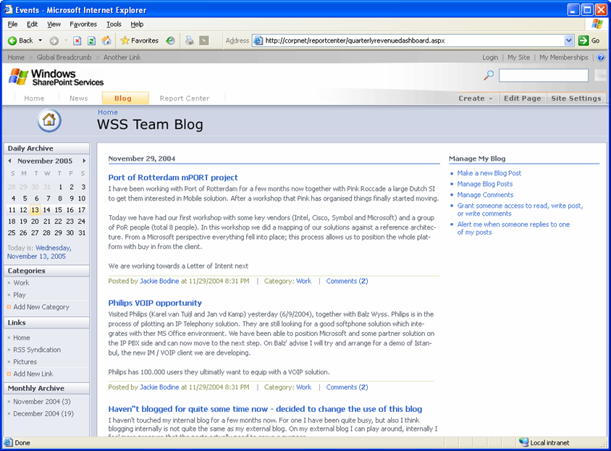
Blog - share IP and knowledge
“Sour Gas” COP
Turn-around
CEO blog
United Way Corporate Challenge
Workflow
Audit
Corporate Record

Slide 35
Customer Examples

Slide 36


Shell environment
A Global Company
112,000 employees in over 130 countries
Increased focus on truly global operations and organizations
Large projects heavily dependent on virtual teaming
Business Challenges
Rapid access to unique expertise whenever and wherever
Workforce dynamics leading to “The Big Crew Change”
Many work locations are environmentally challenging
Unified Communications Solutions
Make it Easy - Put users in control through a single intuitive user interface across desktop, laptop, and Smartphones
Reduce Cost - Optimize deployment through infrastructure consolidation

Slide 37
Customer scenarios in action
Chevron has “desktop of the future” to address information overload
O&G customer finding experts, capturing and sharing knowledge
Vancouver customer’s Gen-Y portal
Career and skill development, new relevant HR approaches
Stay connected with employees, measuring “employee health”
Wiki’s, search, social networking, instant messaging and more
Common HR productivity initiatives
Simplify the toolset
Collaborative culture; remote workers; work from home effectively
People strategy for the future, Gen-X meets Gen-Y

Slide 38
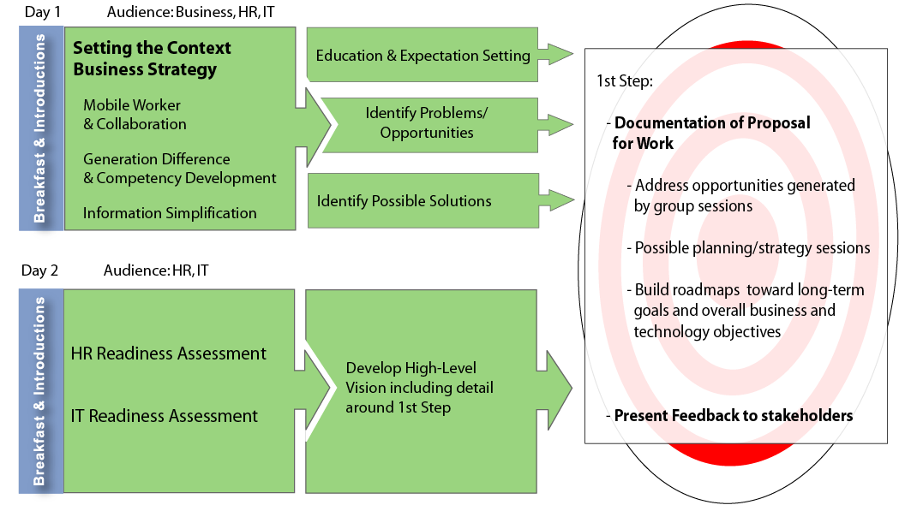
Supporting your workforce change
Ideaca, Rana Group and Microsoft - Our Solutions are tailored to meet individual client needs.

Slide 39
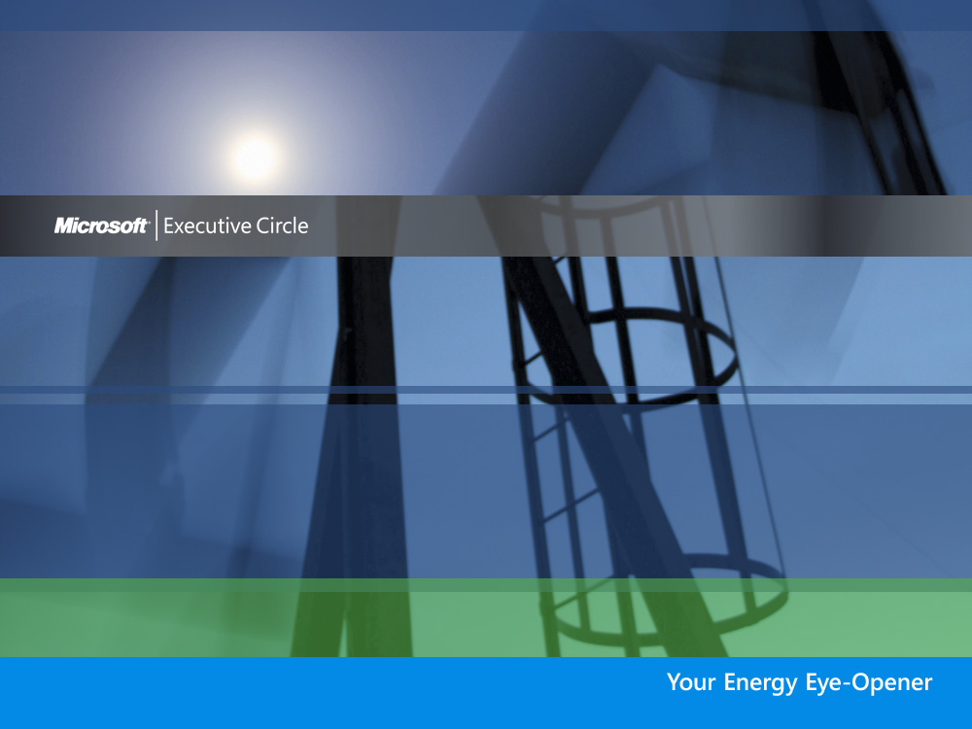
Thank you for your participation at today’s Energy Eye-Opener

